Slide 1
AZ-300T03 M 3: Measure Throughput and Structure of Data Access

Slide 2
Normalized units
In the context of hyperscale cloud database services:
Assist with comparing database tiers
Sometimes represent direct relationship to on-premises equivalents
Can serve as relative performance guarantees

Slide 3
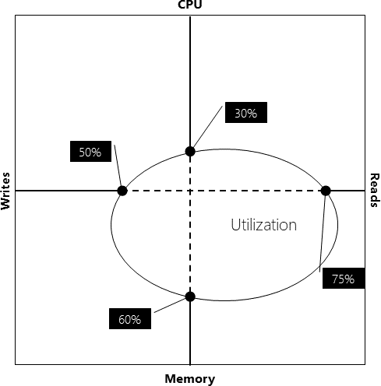
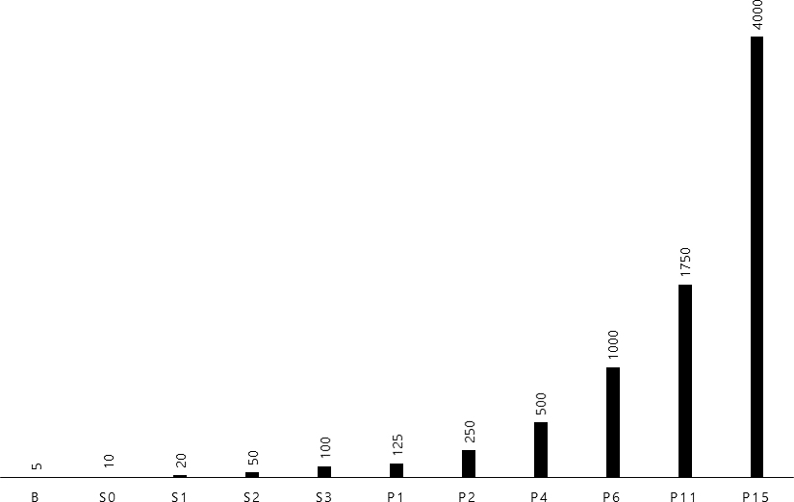
DTUs –Azure SQL Database
The Database Transaction Unit (DTU) model:
Represents a combination of:
CPU
Memory
Read-write performance
Comprises of:
DTUs – single databases
eDTUs – elastic database pools
Describes the capacity of:
3 service tiers:
Basic, Standard, Premium
Multiple performance levels:
within each service tiers

Slide 4
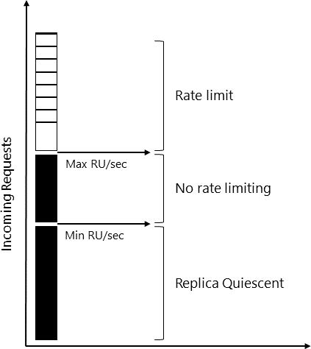
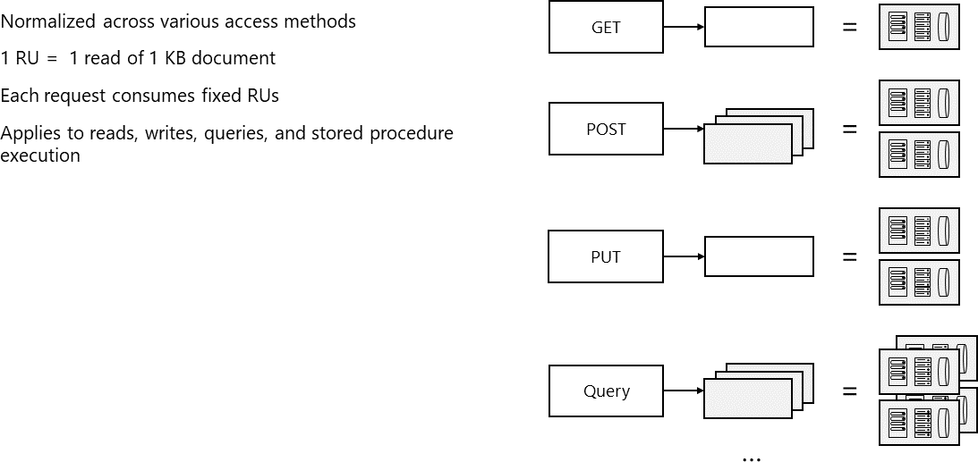
RUs – Azure Cosmos DB
The Request Unit Processing per second (RU/s) model:
Represents a combination of:
CPU
Memory
IOPS
Provides normalized measure of request processing costs:
1 RU is the processing capacity required to read via self-link:
A single item of 1 KB in size with 10 properties

Slide 5
Structured and Unstructured Data
Polyglot persistence:
Represents solutions that use a mix of data store technologies
Underscores the importance of choosing data store based on requirements

Slide 6
Using Structured Data Stores
Relational databases:
Provide data organization:
Based on a well-defined schema
As a series of two-dimensional tables with rows and columns
Supporting Structured Query Language (SQL)
Transactionally-consistent and conforming to ACID model
Are well suited for scenarios that require strong consistency
Are not well suited for scenario that require scaling out
Include Azure managed structured data stores:
Azure SQL Database
Azure Database for MySQL
Azure Database for PostgreSQL

Slide 7
Encrypt data with Transparent Data Encryption (TDE)
Primary TDE characteristics:
Encryption at rest for data and log files of:
SQL Server
Azure SQL Database
Azure SQL Data Warehouse
Real-time I/O encryption and decryption on the page level
The use of a database encryption key (DEK):
The key is stored in the database boot record for availability during recovery.
The key is implemented in one of two ways:
a symmetric key secured by using a certificate stored in the master database of the server
an asymmetric key protected by an Extensible Key Management (EKM) module.

Slide 8
Encrypt data with Always Encrypted
Encryption technology in Azure SQL Database and SQL Server:
helps ensure that sensitive data never appears as plaintext inside the database system.
allows clients to encrypt sensitive data inside client applications and never reveal the encryption keys to the database engine ( SQL Database or SQL Server).
helps protect sensitive data:
at rest on the server
during movement between client and server
while the data is in use
provides a separation between:
those who own the data (and can view it)
those who manage the data (but should have no access).
requires a specialized driver installed on client computers to automatically encrypt and decrypt sensitive data in the client application:
For many applications, this does require some code changes.

